Slide 1
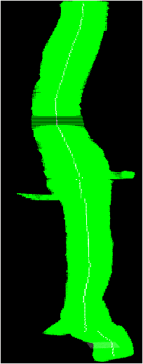
Automatic Segmentation of the Aorta
Kathryn Shea
September 6, 2016

Slide 2
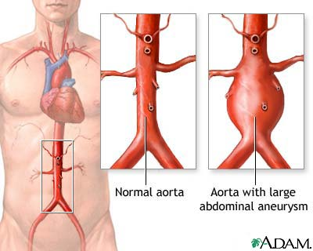
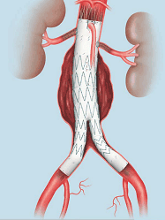
Aortic Aneurysms
Fenestrated Endovascular Stent

Slide 3
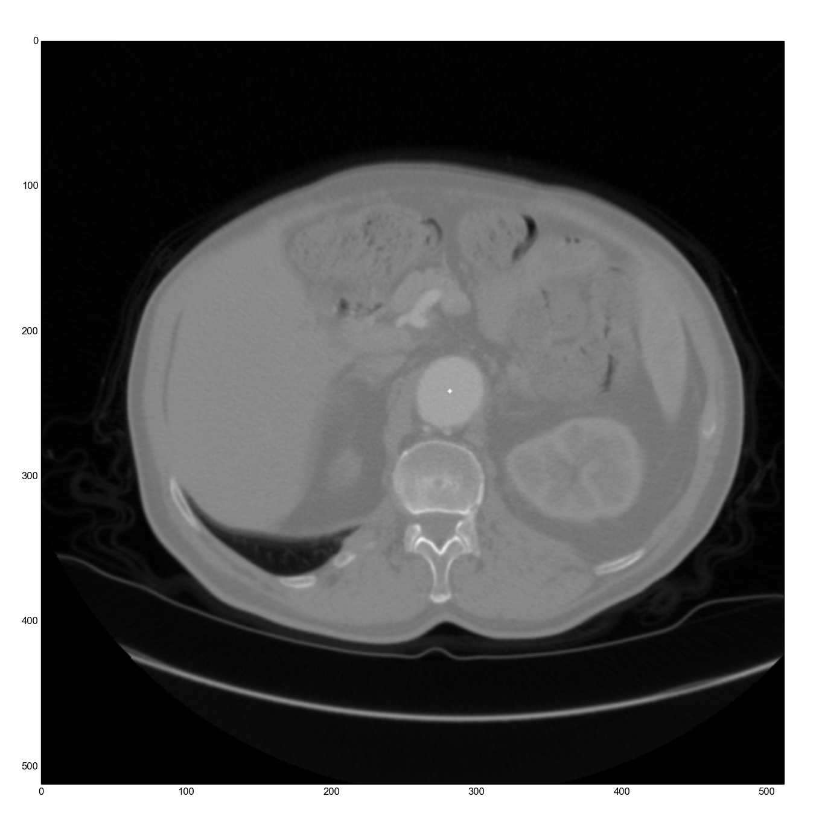
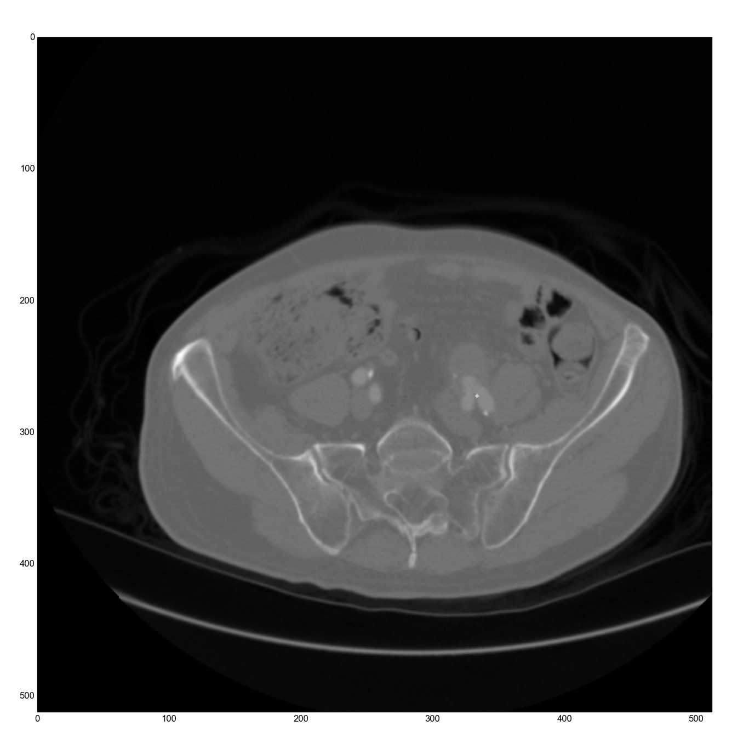
DICOM
Digital Imaging and Communications in Medicine
Contrast MRI of Upper Torso
Contrast MRI of Lower Torso
Femoral Arteries
Aorta

Slide 4
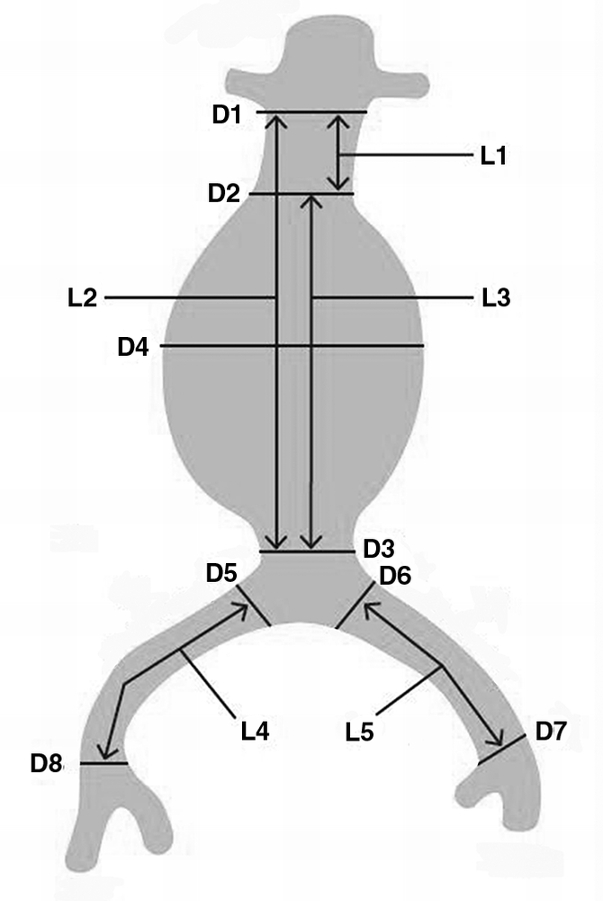
Measurements Required for Stent
Identify Arteries
Separate Aorta Within Image
Calculate Diameters
Find Center Line

Slide 5
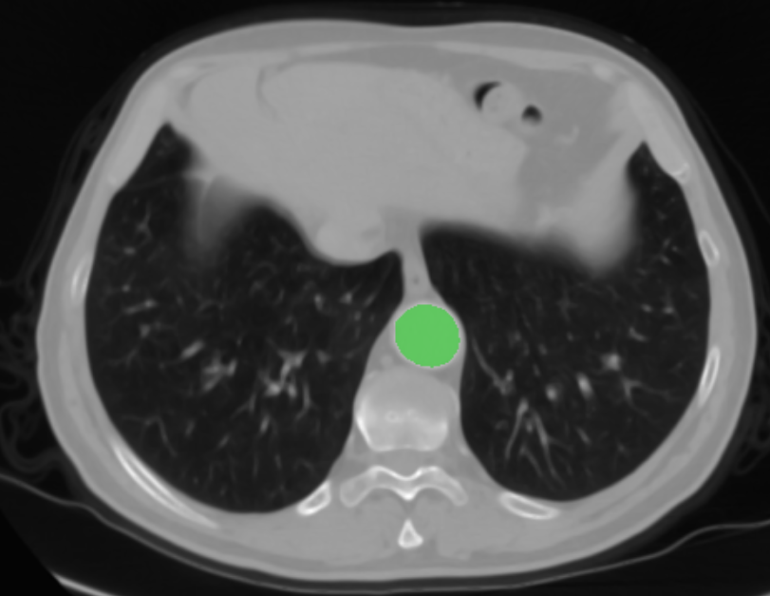
Segmentation

Slide 6
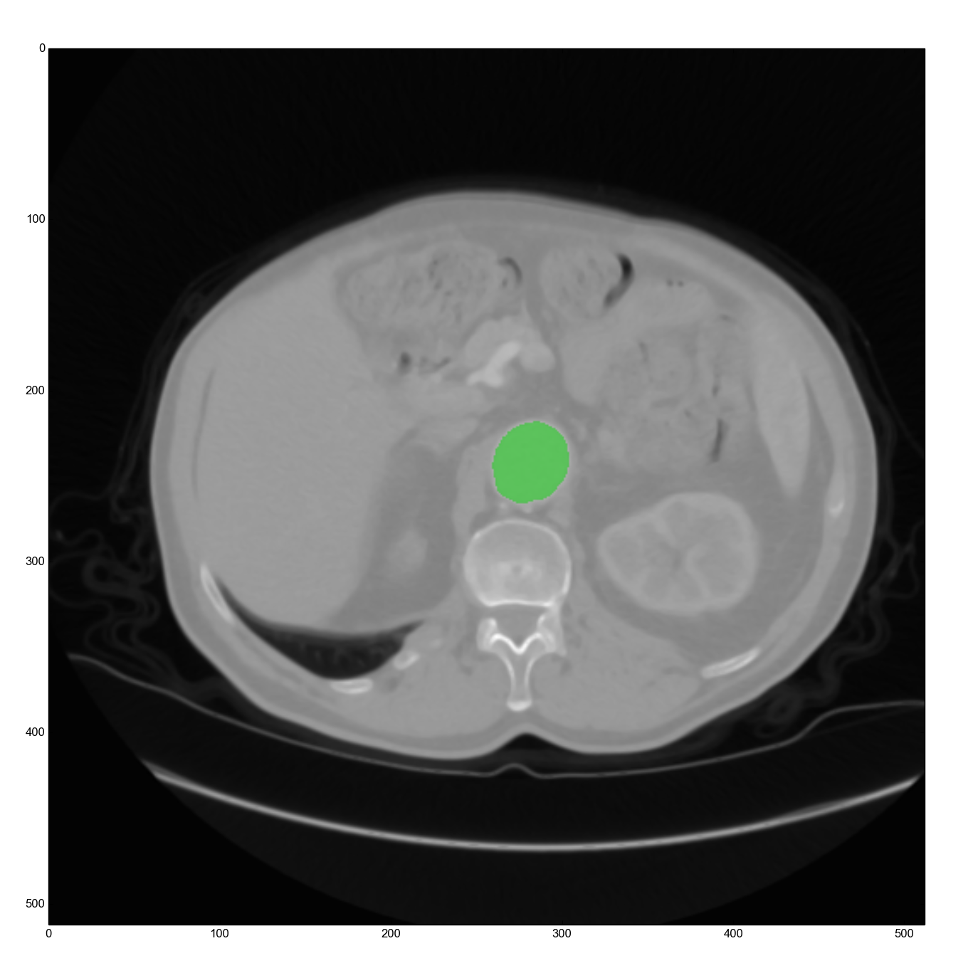

Segmentation
Original Image
512 x 512 pixels
2D grayscale array
Underneath segmented image
Segmentation
512 x 512 pixels
2D binary array
0’s are transparent
1’s are green
Overlaid original image
SITK Library

Slide 7
Segmentation
Binary Array (Segmented Image)
0 | 0 | 0 | 0 | 1 | 0 | 0 | 0 | 0
0 | 0 | 1 | 1 | 1 | 1 | 1 | 0 | 0
0 | 1 | 1 | 1 | 1 | 1 | 1 | 1 | 0
0 | 1 | 1 | 1 | 1 | 1 | 1 | 1 | 0
1 | 1 | 1 | 1 | 1 | 1 | 1 | 1 | 1
0 | 1 | 1 | 1 | 1 | 1 | 1 | 1 | 0
0 | 1 | 1 | 1 | 1 | 1 | 1 | 1 | 0
0 | 0 | 1 | 1 | 1 | 1 | 1 | 0 | 0
0 | 0 | 0 | 0 | 1 | 0 | 0 | 0 | 0

Slide 8
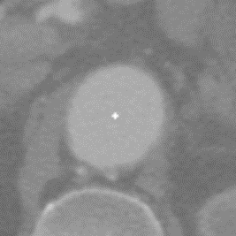
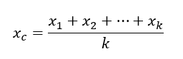
Segmentation: Centroid
Center of Gravity Equation:

Slide 9
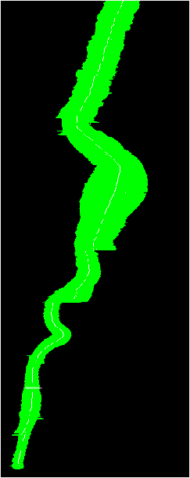
Segmentation & 3D Modelling
Basic Process
Segmented one image
Propagate outwards to next images
Calculate centroid of segmentation
Segment with centroid in next image
Compare segmented section with previous one and check for sufficient overlap
Sometimes segmentations go poorly…

Slide 10
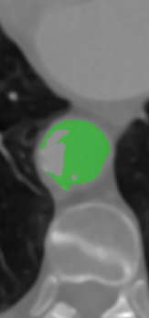
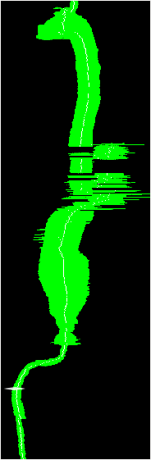
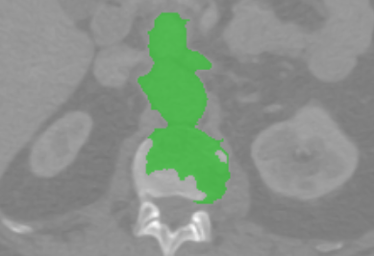
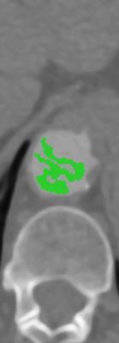
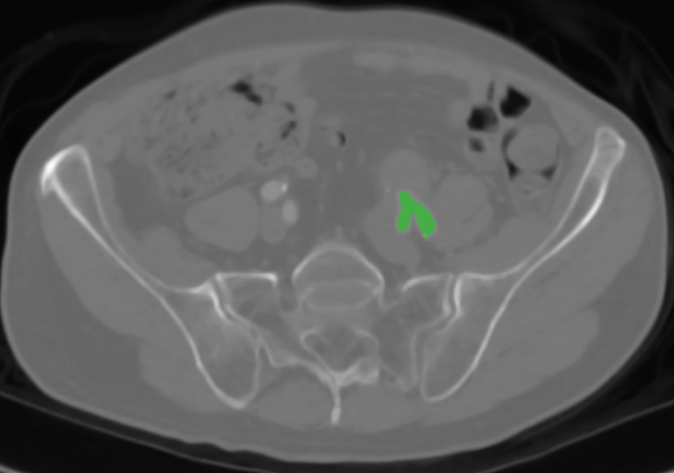
A
B
C
D
E

Slide 11
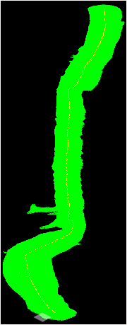
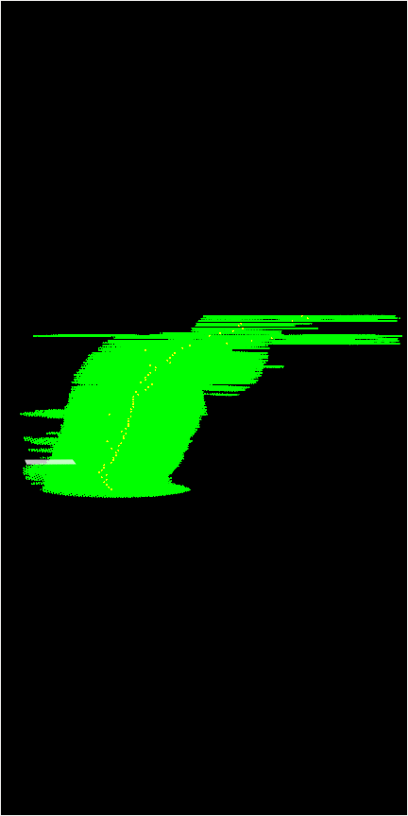
A
B
C
D
E

Slide 12
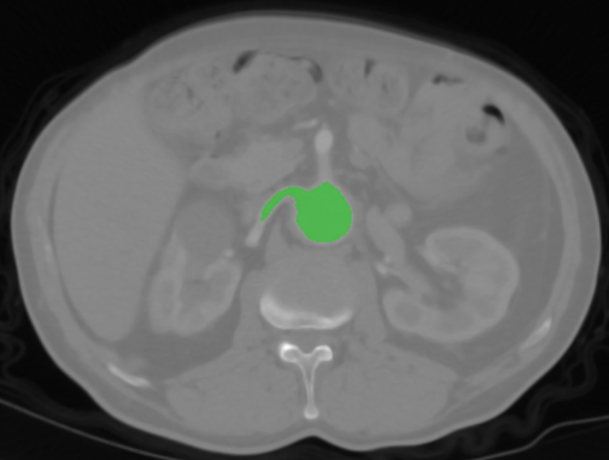
Identifying Arteries

Slide 13
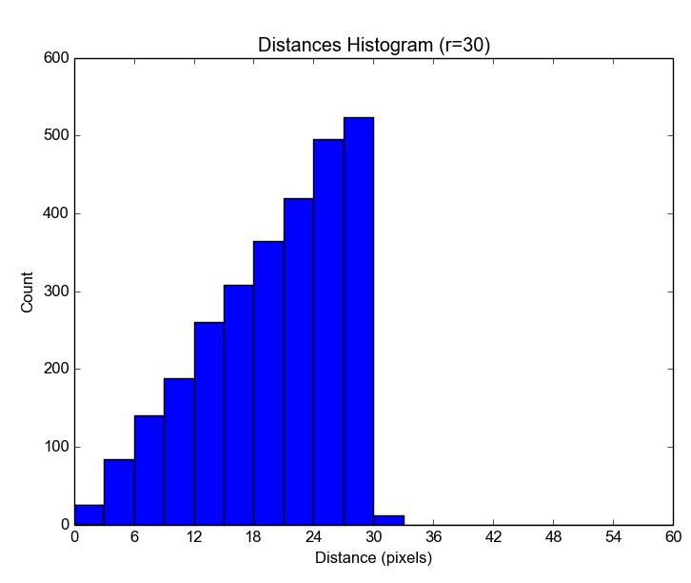
Identifying Arteries: what does a circle look like?
Shape (array, r=4)
Distances Histogram (r=30)
0 | 0 | 0 | 0 | 4.0 | 0 | 0 | 0 | 0
0 | 0 | 3.6 | 3.2 | 3.0 | 3.2 | 3.6 | 0 | 0
0 | 3.6 | 2.8 | 2.4 | 2.0 | 2.4 | 2.8 | 3.6 | 0
0 | 3.2 | 2.4 | 1.4 | 1.0 | 1.4 | 2.4 | 3.2 | 0
4.0 | 3.0 | 2.0 | 1.0 | 0.0 | 1.0 | 2.0 | 3.0 | 4.0
0 | 3.2 | 2.4 | 1.4 | 1.0 | 1.4 | 2.4 | 3.2 | 0
0 | 3.6 | 2.8 | 2.4 | 2.0 | 2.4 | 2.8 | 3.6 | 0
0 | 0 | 3.6 | 3.2 | 3.0 | 3.2 | 3.6 | 0 | 0
0 | 0 | 0 | 0 | 4.0 | 0 | 0 | 0 | 0

Slide 14
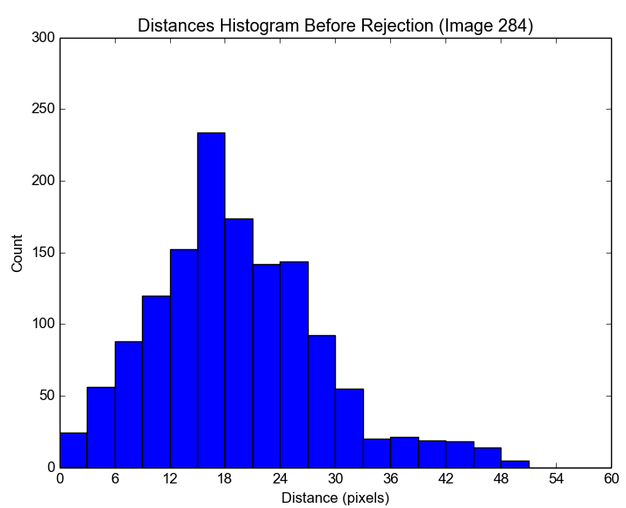
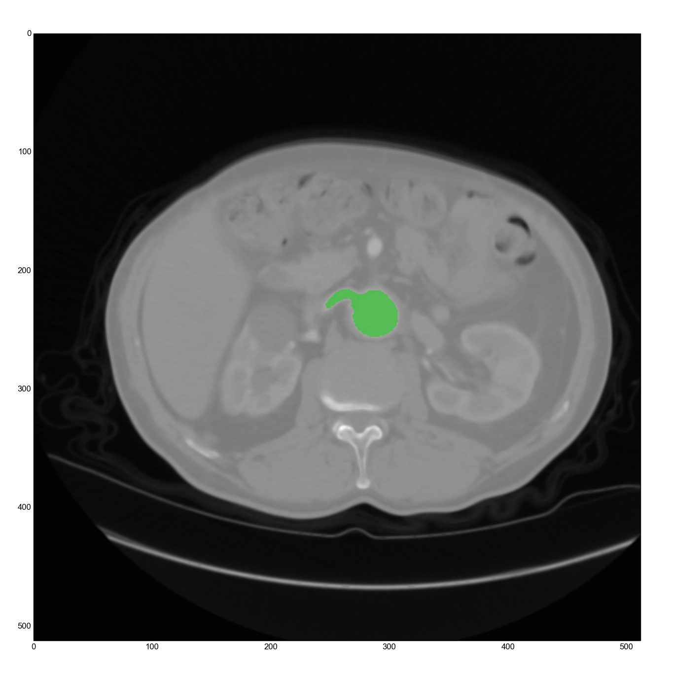
Identifying Arteries: what does an artery look like?
A
B

Slide 15
Identifying Arteries: Basic Process
Create list of distances by calculating BFS distance from centroid to each pixel
Sort list
Calculate average of lower 1/3 of the list (lower avg)
Calculate average of upper 1/3 of list (upper avg)
If upper avg / lower avg > threshold, it’s an artery
What should the threshold be?

Slide 16
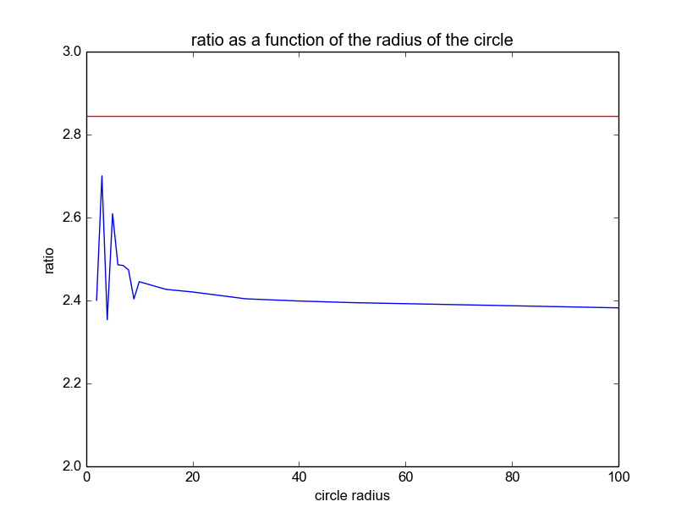
Deciding the Threshold: threshold for a circle
Ratio as a function of the radius of the circle
Max Ratio: 2.7
Ratio increases as shape becomes more like an oval
Ratio for images with arteries approx.: 2.9 – 3.1
Threshold: 2.845
ratio
radius

Slide 17
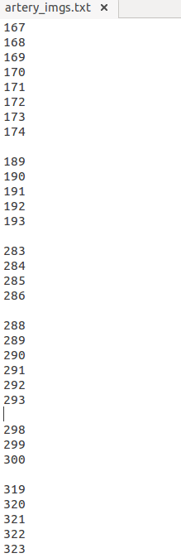
Identifying Arteries: Results
Femoral
Artery
Patient 1:
253 images analyzed in successfully segmented data set
95% (239/252) were correctly identified
5% (13/252) were identified as “arteries” when they were, in fact, femoral arteries either taking strange forms or splitting into two more arteries before stopping segmentation
Aortic Bifurcation
Artery
Artery
Artery
Artery

Slide 18
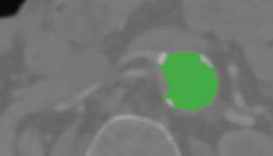
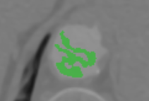
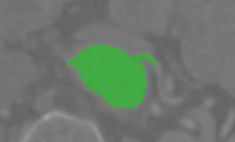
Identifying Arteries: Results
A
Patient 2:
485 images analyzed in successfully segmented data set
98% (477/485) were correctly identified
2% (8 images) were either not identified or falsely identified because:
artery wasn’t segmented at all
poor segmentation
the artery segmentation was very short
B
C

Slide 19
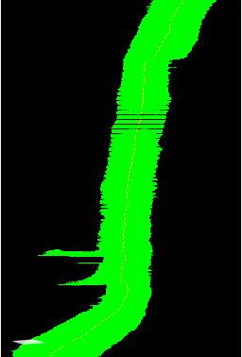
Identifying Arteries: Conclusions
Largely successful for aortic analysis
Not successful for femoral analysis

Slide 20
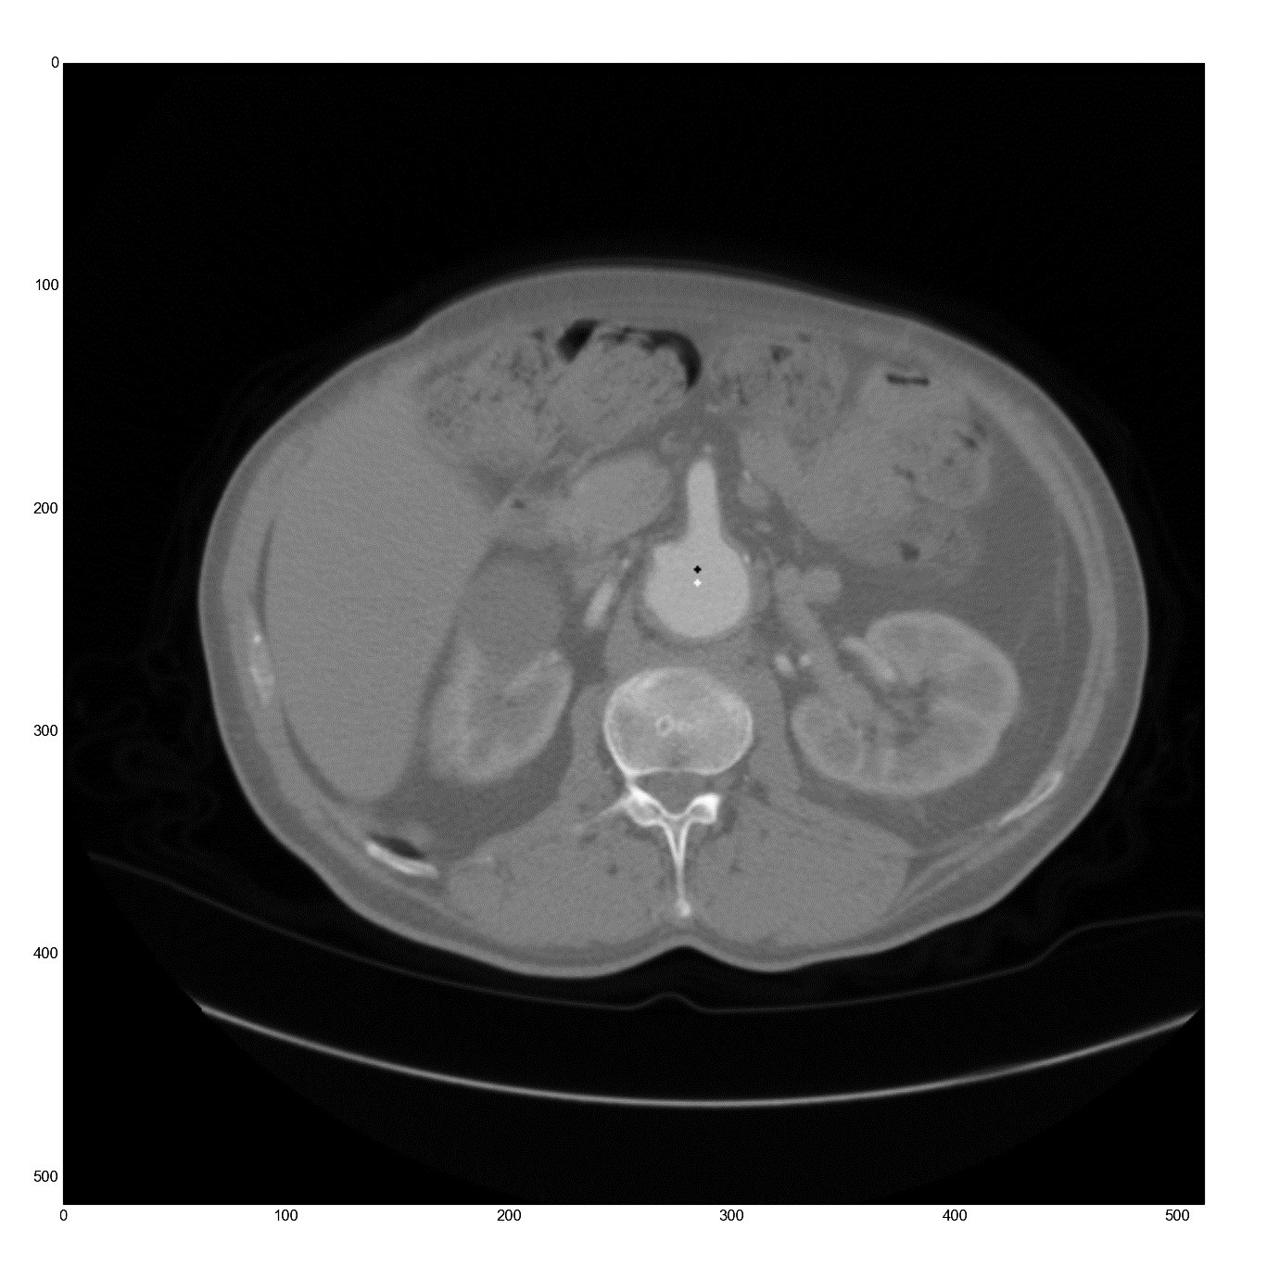
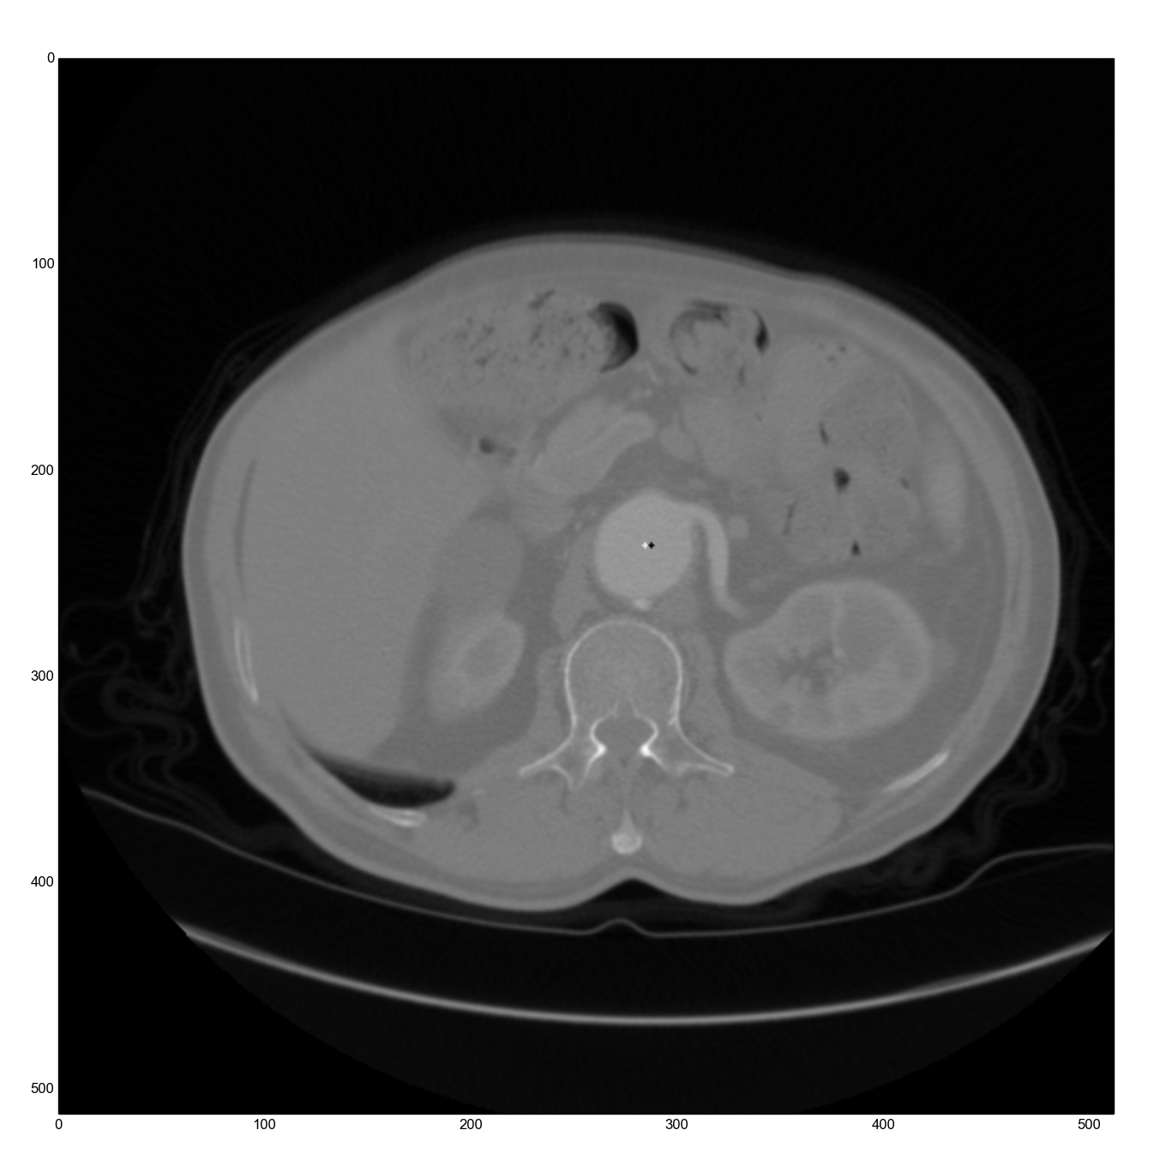
Fixing the Centroid

Slide 21
Fixing the Centroid
Basic Process:
Determine there is an artery present
Sample edge points
Calculate centroid of edge points
Approximate circle using histogram (“trim” the arteries)
Calculate centroid of approximated circle area

Slide 22
Fixing the Centroid: sampling and rejecting edge points

Slide 23
Fixing the Centroid: what does a circle look like?
Shape (array, r=4)
Distances Histogram (r=30)
0 | 0 | 0 | 0 | 4.0 | 0 | 0 | 0 | 0
0 | 0 | 3.6 | 3.2 | 3.0 | 3.2 | 3.6 | 0 | 0
0 | 3.6 | 2.8 | 2.4 | 2.0 | 2.4 | 2.8 | 3.6 | 0
0 | 3.2 | 2.4 | 1.4 | 1.0 | 1.4 | 2.4 | 3.2 | 0
4.0 | 3.0 | 2.0 | 1.0 | 0.0 | 1.0 | 2.0 | 3.0 | 4.0
0 | 3.2 | 2.4 | 1.4 | 1.0 | 1.4 | 2.4 | 3.2 | 0
0 | 3.6 | 2.8 | 2.4 | 2.0 | 2.4 | 2.8 | 3.6 | 0
0 | 0 | 3.6 | 3.2 | 3.0 | 3.2 | 3.6 | 0 | 0
0 | 0 | 0 | 0 | 4.0 | 0 | 0 | 0 | 0

Slide 24
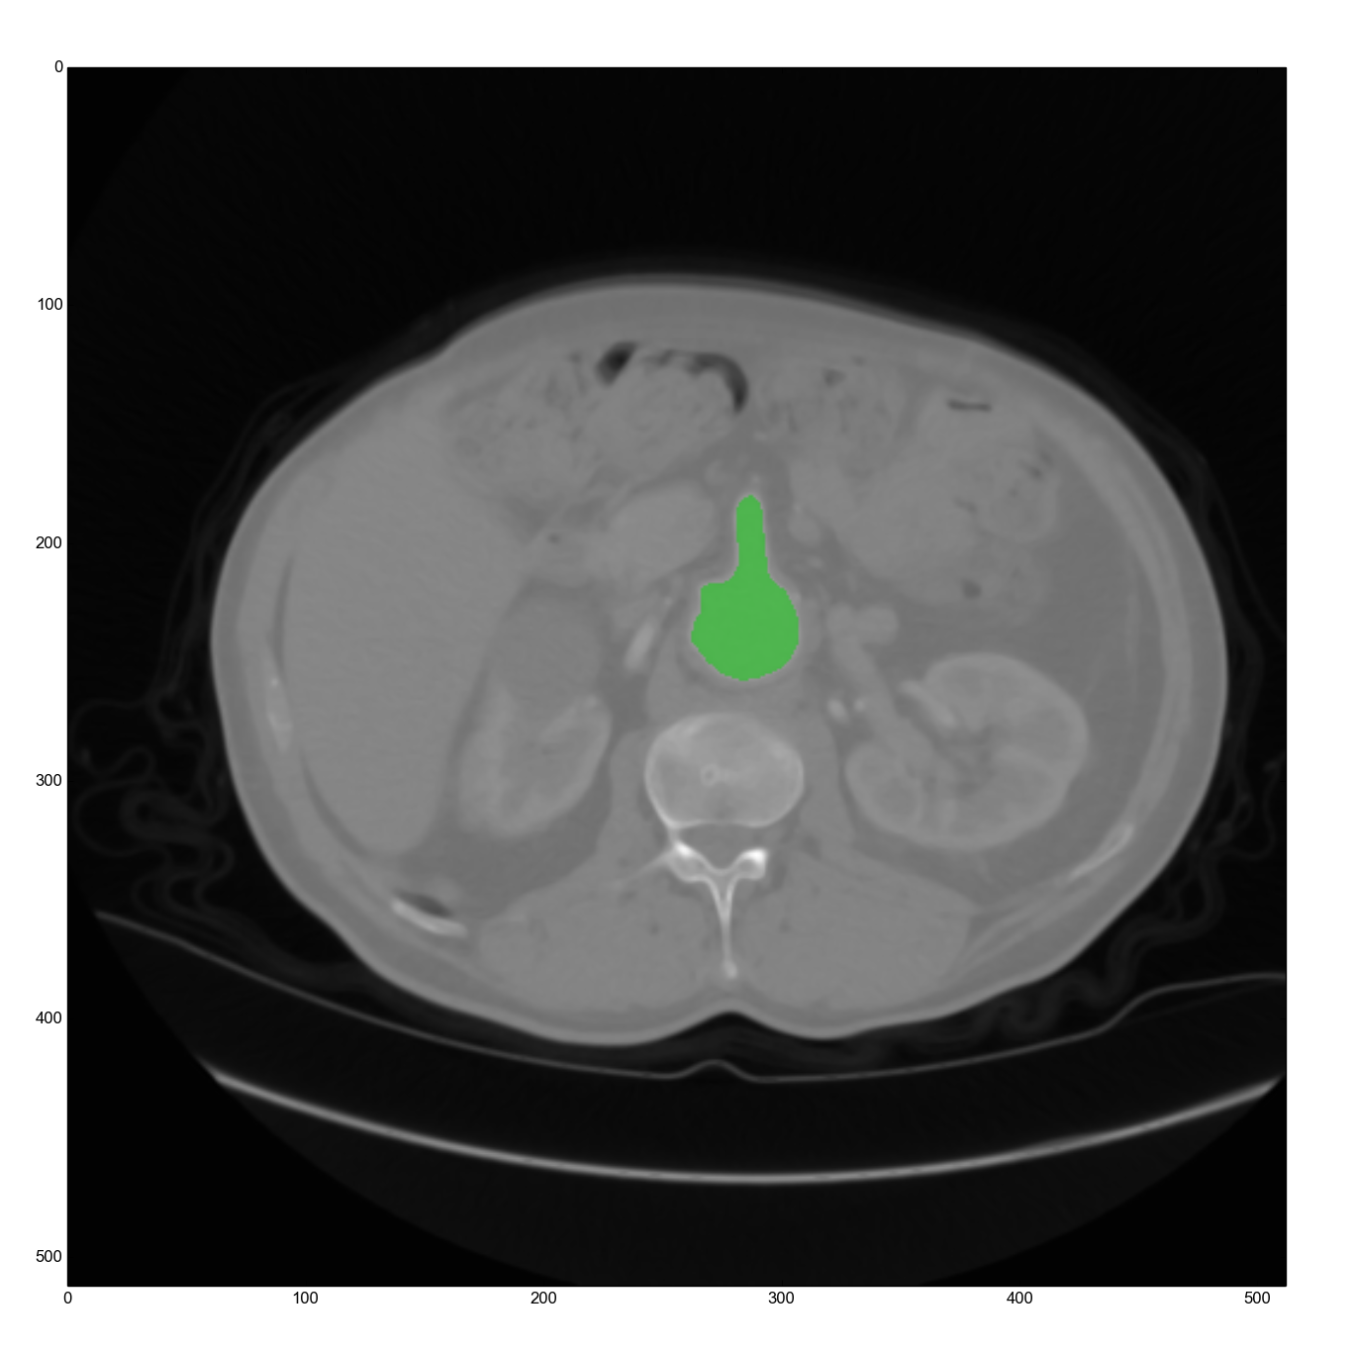
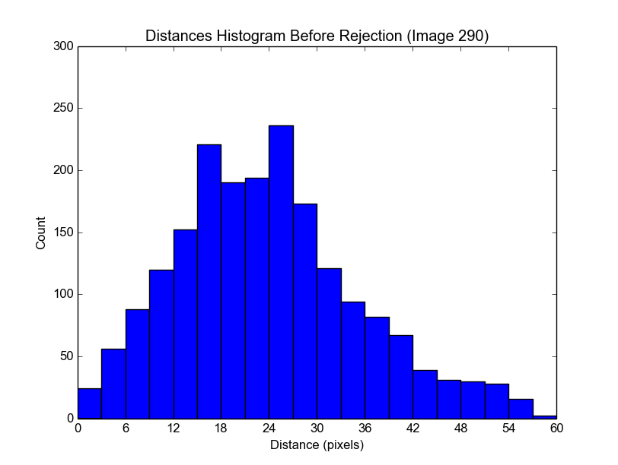
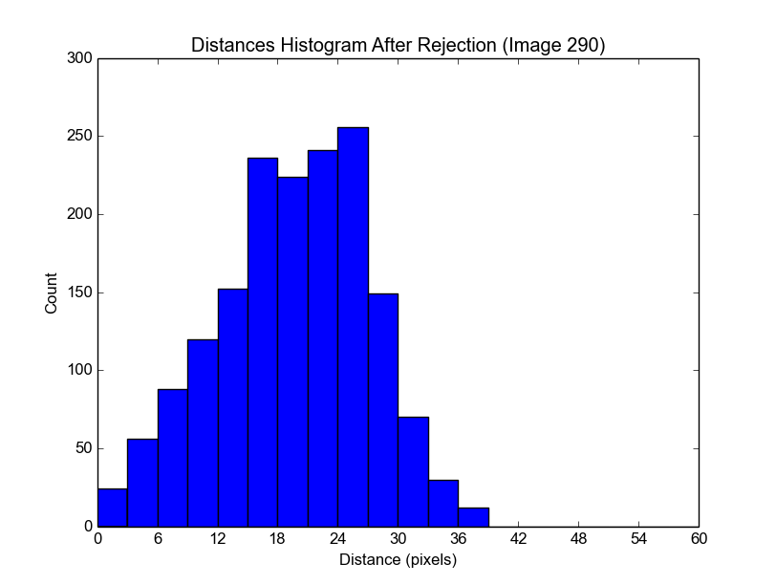

A #290
B
C
D
E

Slide 25
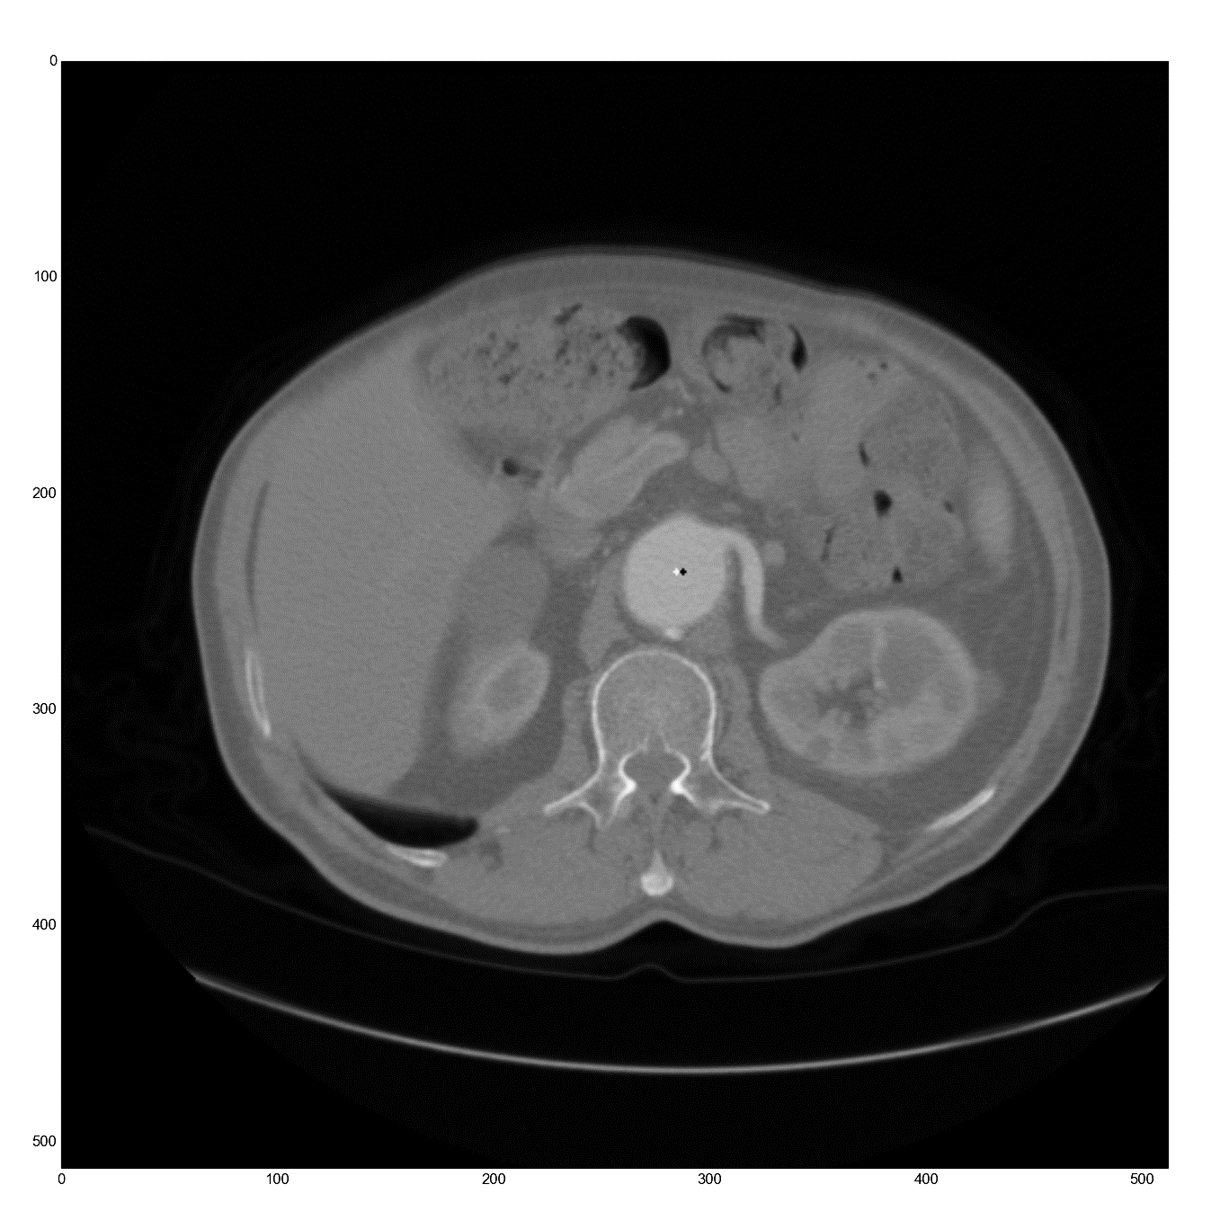
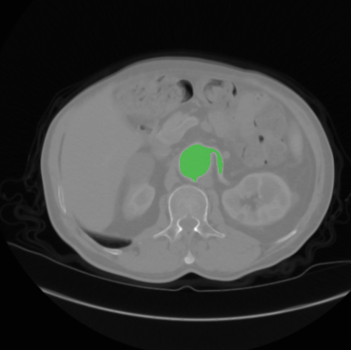
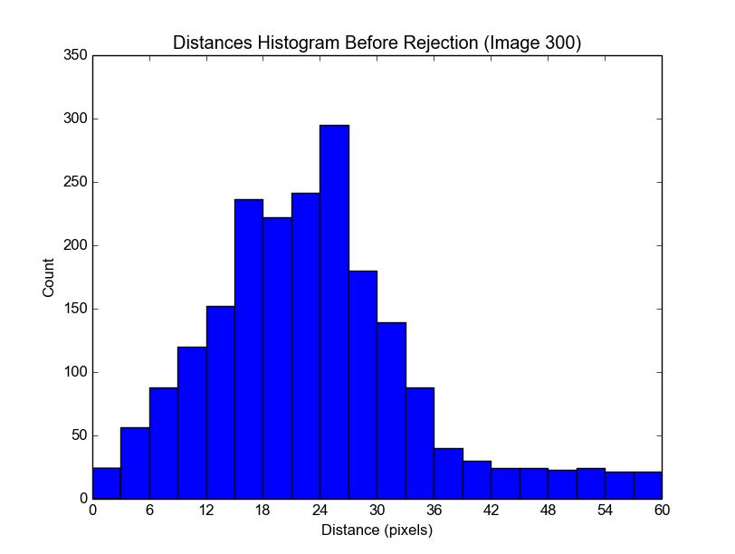
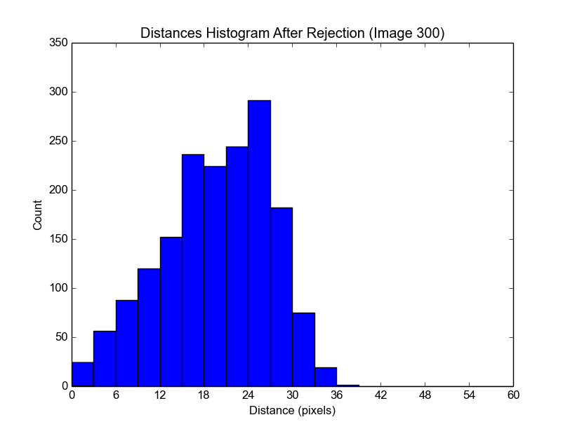

A #300
B
C
D
E

Slide 26
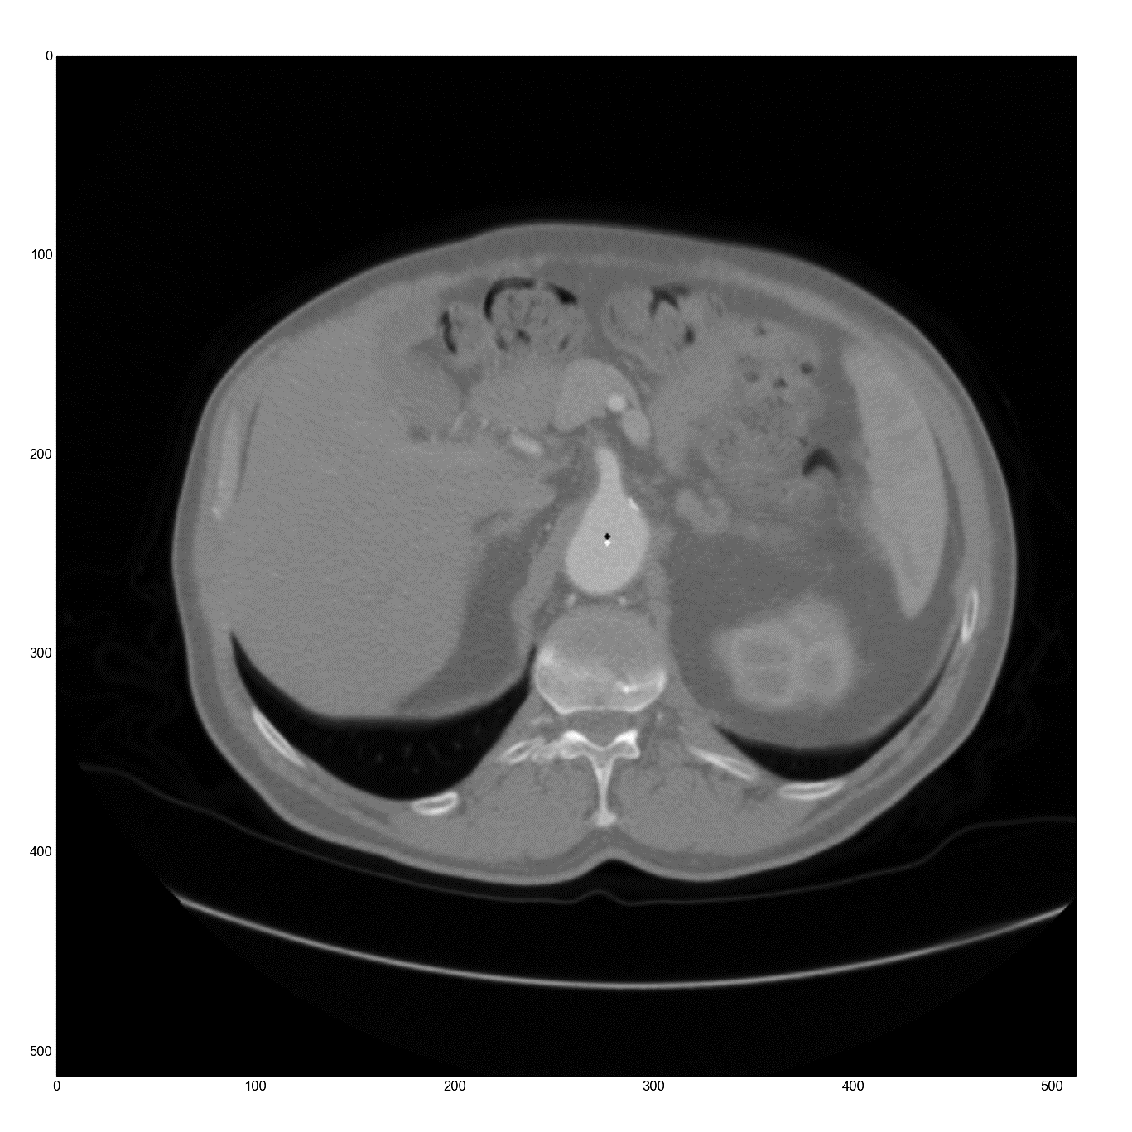
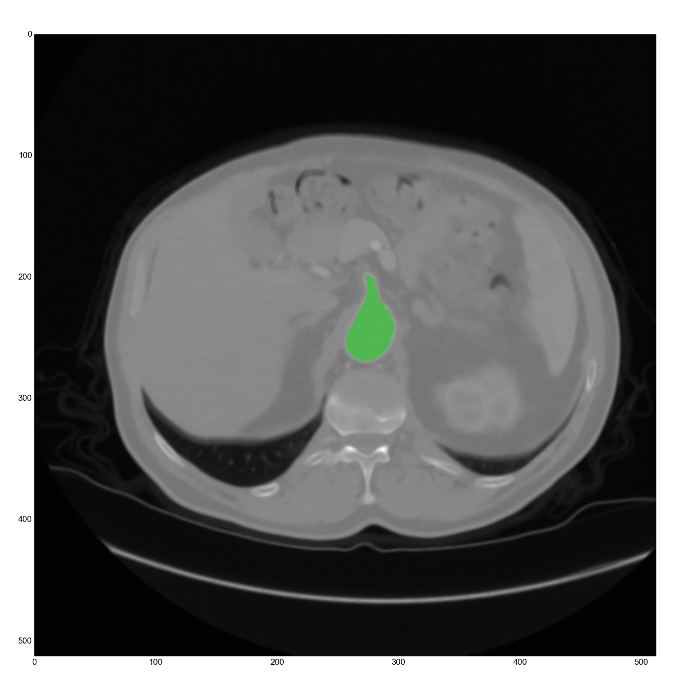
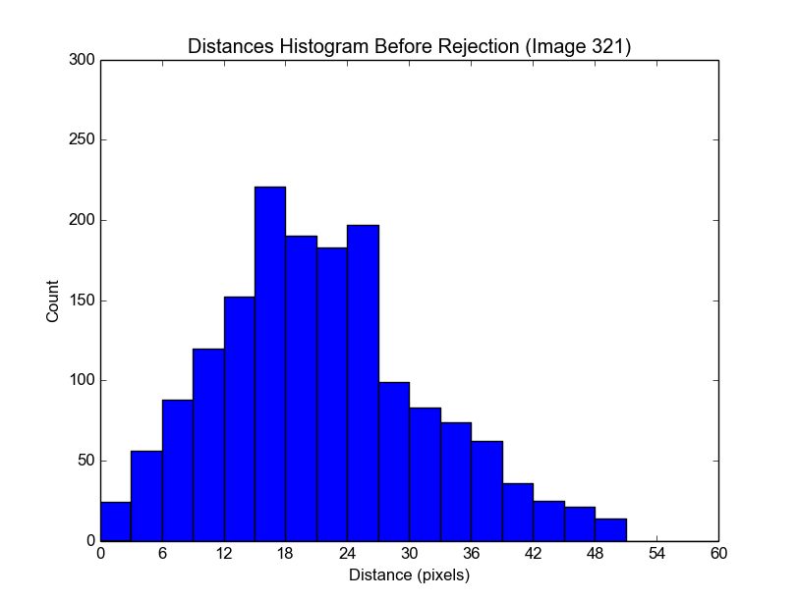
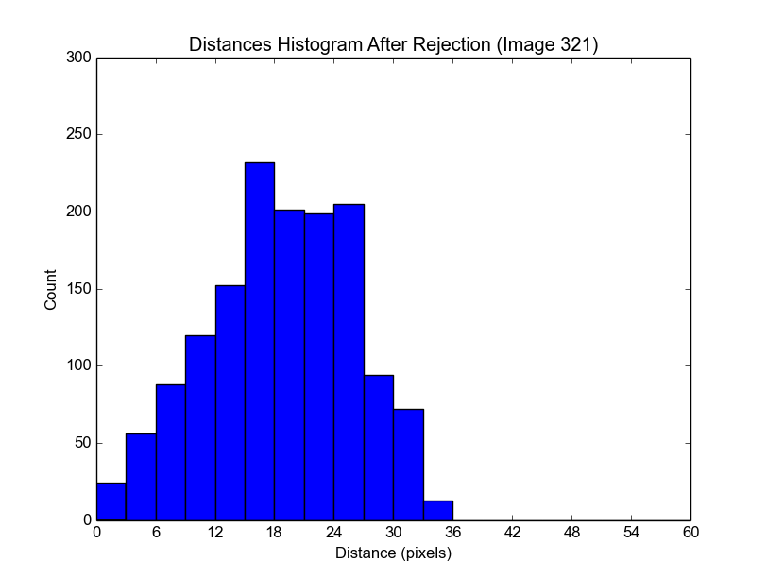
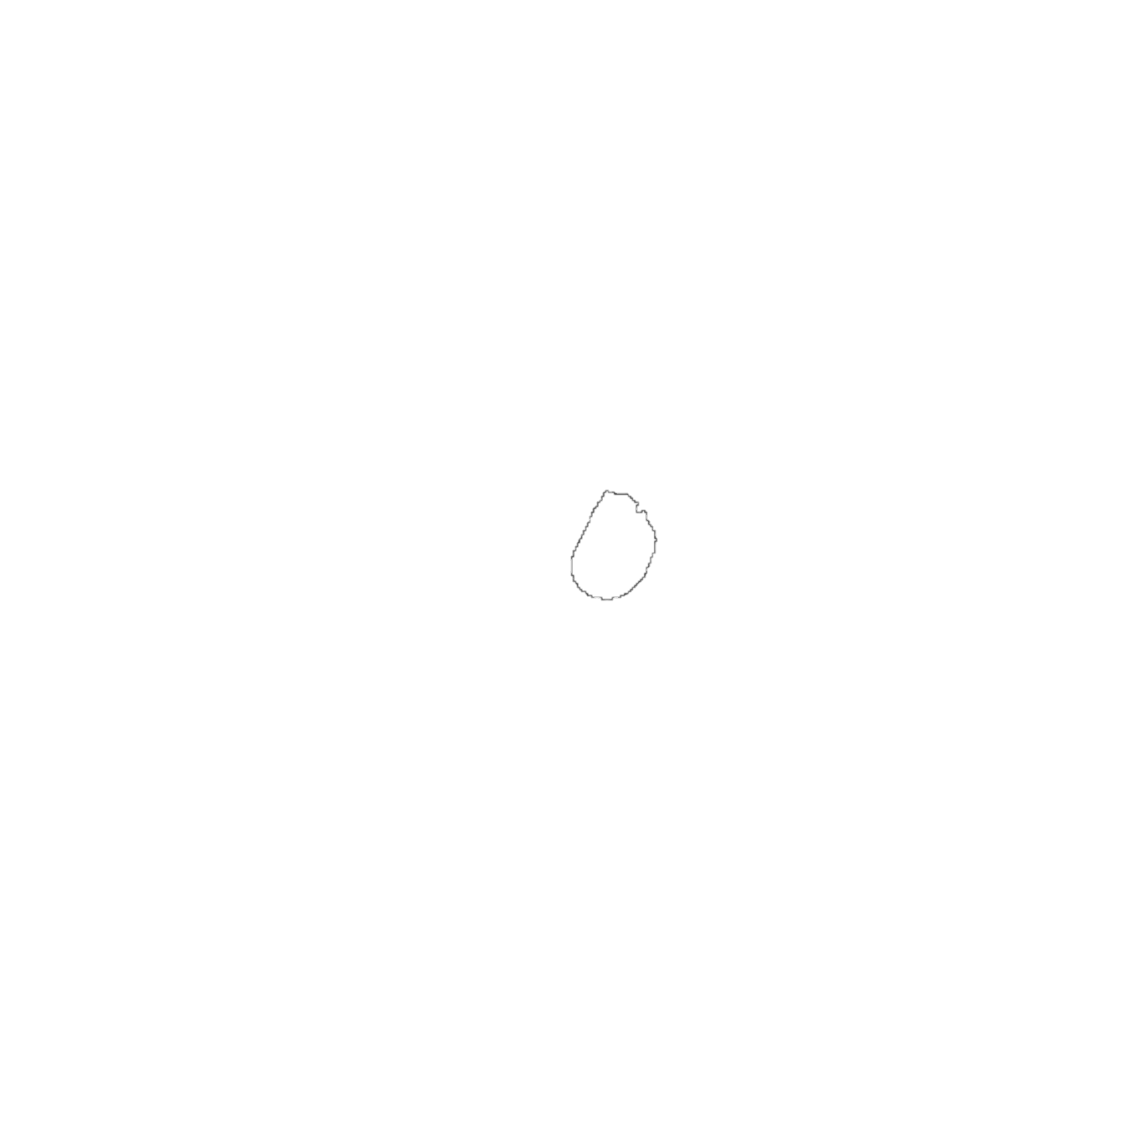
A #321
B
C
D
E

Slide 27
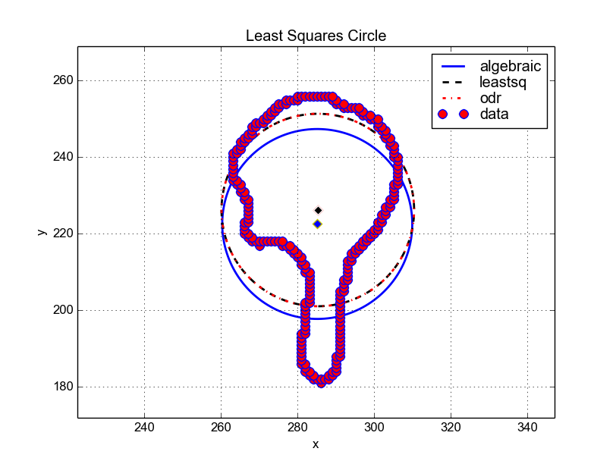
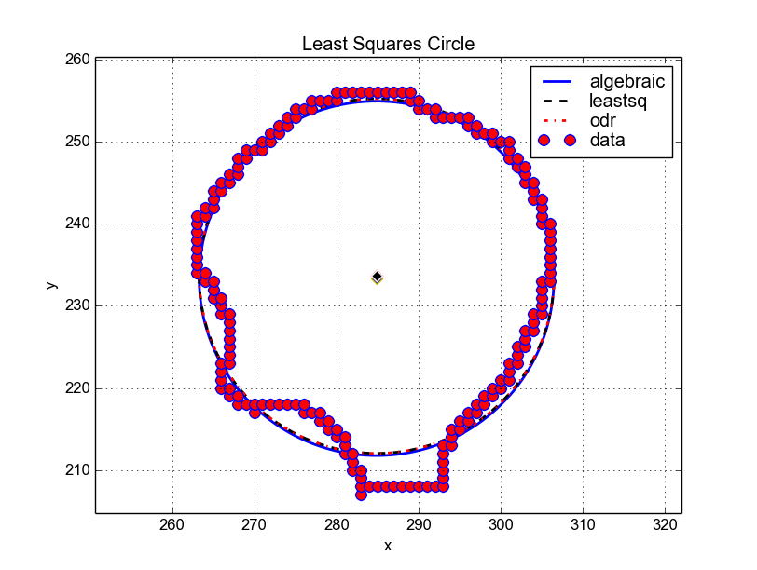
Fixing the Centroid: Circle Fitting

Slide 28
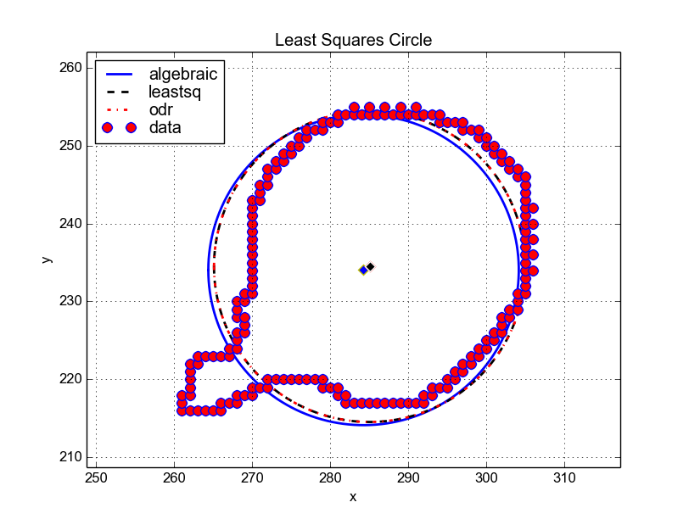
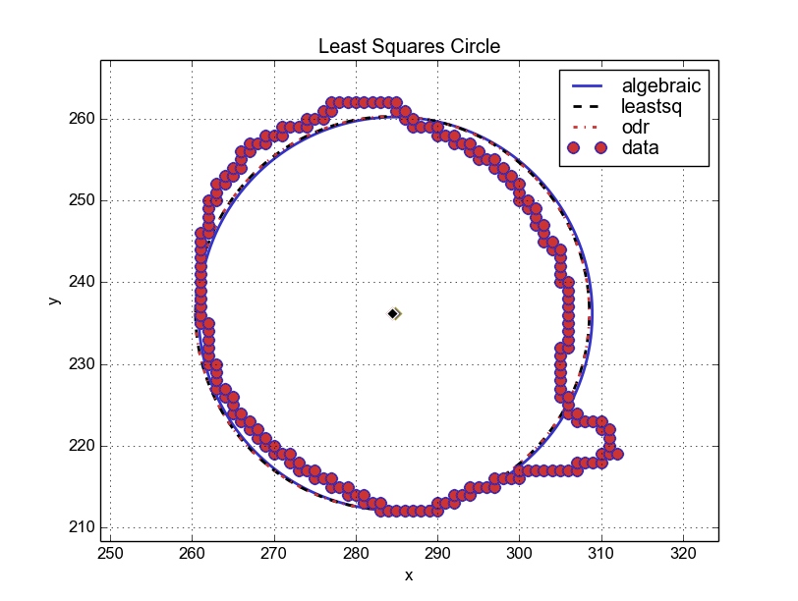
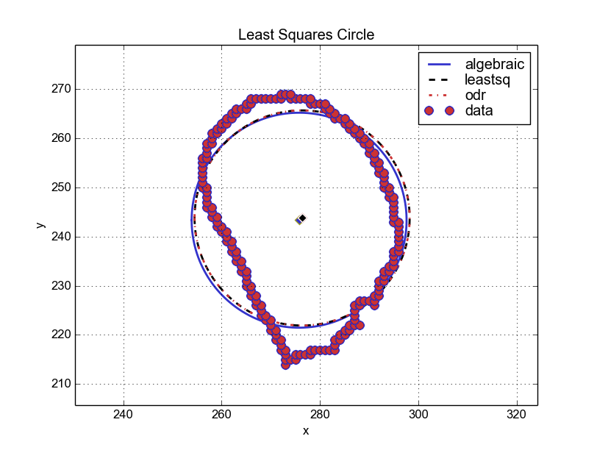
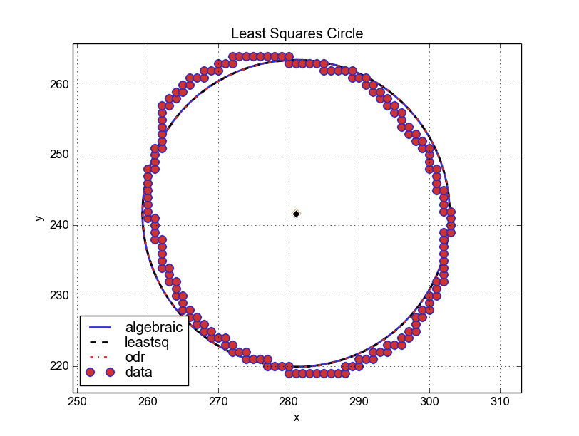
Fixing the Centroid: Results & Conclusion
Image Number | Center of Gravity | Circle Fitting Center | Difference
284 | (285, 234) | (284.84, 234.50) | (+0.84, +0.50)
290 | (284, 233) | (284.86, 233.35) | (+0.86, +0.35)
300 | (284, 236) | (284.66, 236.10) | (+0.66, +0.10)
310 | (281, 241) | (281.11, 241.76) | (+0.11, +0.76)
321 | (276, 244) | (276.45, 244.36) | (+0.45, +0.36)
#284
#300
#321
#310

Slide 29
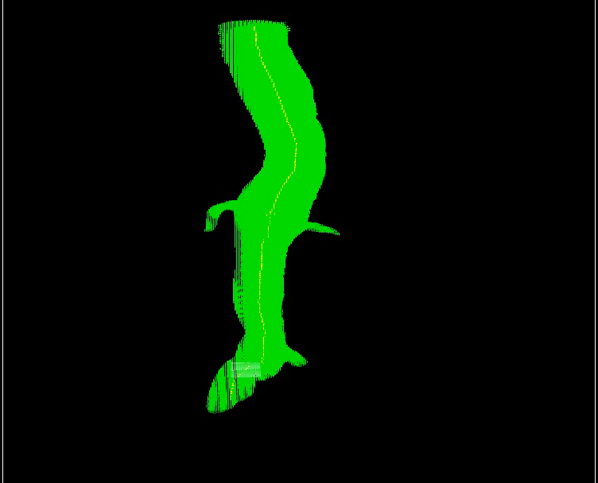
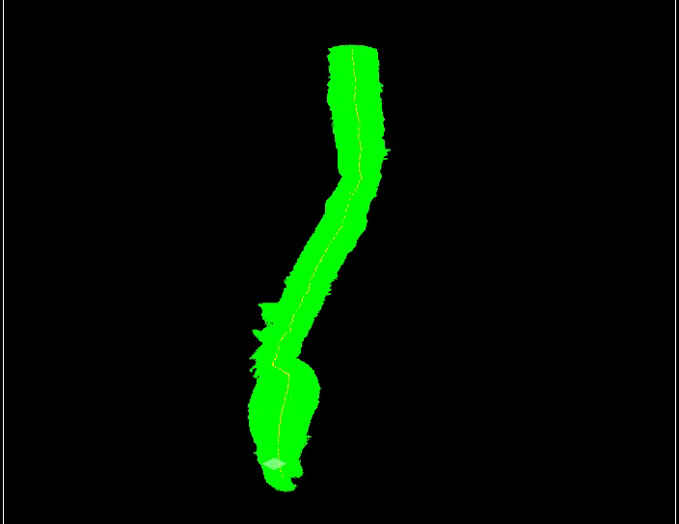
The End
#1
In Review:
Segmentation (paint bucket and propagation)
Calculating Centroid (center of gravity)
Identifying Arteries (histograms, ratios, and a threshold)
Centerline Calculation (trimming & recalculating; circle fitting)
Questions?
#2

Slide 30
Extra Slides

Slide 31


Next Step: Diameter
(pixels)
(pixels)

Slide 32
Segmentation: Fixes
Problems | Fixes
Femoral Arteries | Multiple clicks from user on first image
Propagation Error (insufficient overlap, false centroid) | Request another click from the user
Spine Interference | Solved in past papers
Poor Segmentation | Customized edge detection function or Customized averaging color function

Slide 33


Fixing the Centroid: Results
B
A #310
Distances Histogram
C
Count
Distance (Pixels)

Slide 34



A #284
B
C
D
E

